Slide 1
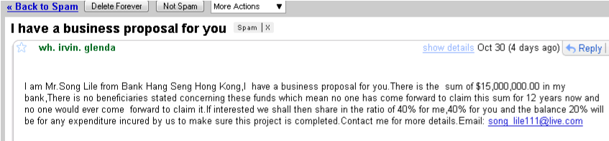
How does computer know what is spam and what is ham?

Slide 2
Attempt 1:
(define (spam? email)‏
(cond ( (email from known sender) False)‏
( (email contains “viagra”) True)‏
( (email begins with “Dear Mr/Mrs.”) True)‏
( (email contains URL) True)‏
( (email contains attachment) True)‏
( ...

Slide 3
Attempt 1:
(define (spam? email)‏
(cond ( (email from known sender) False)‏
( (email contains “viagra”) True)‏
( (email begins with “Dear Mr/Mrs.”) True)‏
( (email contains URL) True)‏
( (email contains attachment) True)‏
( ...
Problem: (email contain URL) is an indication, NOT a PROOF

Slide 4
Features: Score:
email from known sender -50
email contains "viagra" 75
email begins with "Dear Mr/Mrs." 70
email contains URL 10
email contains attachment 5
... ... ...
If Total Sum > 100, classify as spam.

Slide 5
Features: Score:
email from known sender -50
email contains "viagra" 75
email begins with "Dear Mr/Mrs." 70
email contains URL 10
email contains attachment 5
... ... ...
If Total Sum > 100, classify as spam.
Problems:
- How to determine the score?
- How to combine the score?

Slide 6
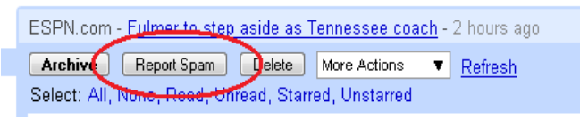
Key Idea:
Learn which features are important through examples
Training Set:
lots of emails with correct labels
(both spam and ham)

Slide 7
The Naive Bayes Algorithm:
Step 1. Gather Statistics inside Training Set:

Slide 8
The Naive Bayes Algorithm:
Step 1. Gather Statistics inside Training Set:
- Count percentage of spams in Training Set: P(spam)‏
- Count percentage of hams in Training Set: P(ham)‏
- For every feature F_1, F_2, F_3 ... :
= Count percentage of spams with feature F_i : P(F_i | spam)‏
= Count percentage of hams with feature F_i : P(F_i | ham)‏

Slide 9
The Naive Bayes Algorithm:
Say, F_1 = email contains “viagra”
F_2 = email begins with “Dear Mr/Mrs.”

Slide 10
The Naive Bayes Algorithm:
Say, F_1 = email contains “viagra”
F_2 = email begins with “Dear Mr/Mrs.”
From Training Set, we discovered:
P(spam) = 0.85 P(ham) = 0.15
P(F_1 | spam) = 0.2 P(NOT F_1 | spam) = 0.8
P(F_1 | ham) = 0.001 P(NOT F_1 | ham) 0.999
P(F_2 | spam) = 0.99 P(NOT F_2 | spam) = 0.01
P(F_2 | ham) = 0.0001 P(NOT F_2 | ham) = 0.9999

Slide 11
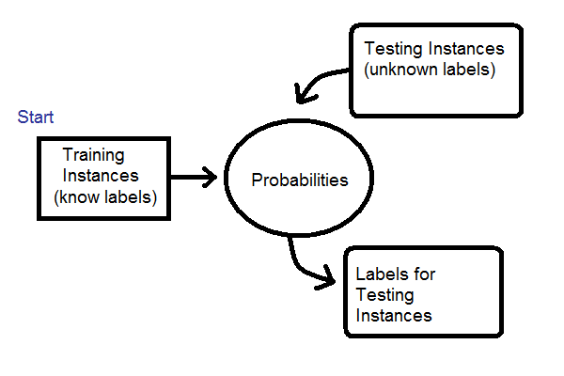

Slide 12
The Naive Bayes Algorithm:
Step 1. Gather Statistics inside Training Set:
- Count percentage of spams in Training Set: P(spam)‏
- Count percentage of hams in Training Set: P(ham)‏
- For every feature F_1, F_2, F_3 ... :
= Count percentage of spams with feature F_i : P(F_i | spam)‏
= Count percentage of hams with feature F_i : P(F_i | ham)‏
Step 2. On a new Instance:
- Find what features the new instance has
- Use Bayes Rule to compute probability
- Take the most probable label

Slide 13
Example:
Optical Character Recognition
GOAL: recognize scanned hand-written numbers
............................
......++++++................
......##############++......
......+++++##########+......
............+.+++++##+......
..................+##.......
.................+##+.......
.................+##+.......
................+##+........
................+#+.........
................##+.........
...............+#+..........
..............+##+..........
..............##+...........
.............###+...........
............+##+............
...........+##+.............
...........+##+.............
..........+###+.............
..........+###+.............
..........+##...............
............................
............................
............................
............+#..............
..........+###..............
.........+####+.............
.........+######+...........
........+###+####+..........
........+##..+####..........
........+#+...+##+..........
........+#+...###+..........
........+##+++####+.........
.........#####++##+.........
.........+###+..+##+........
..........+++....+#+........
.................+##........
..................+#+.......
..................+##+......
...................+#+......
...................+##+.....
....................+#+.....
.....................+#+....
......................#+....
............................

Slide 14
Instance – scanned image of hand-written number
Labels – 1,2,3,4,5,6,7,8,9
Features – (for project)‏
every 2x2 pixel squares

Slide 15
Instance – scanned image of hand-written number
Labels – 1,2,3,4,5,6,7,8,9
Features – (for project)‏
every 2x2 pixel squares
............................
............................
............+#..............
..........+###..............
.........+####+.............
.........+######+...........
........+###+####+..........
........+##..+####..........
........+#+...+##+..........
........+#+...###+..........
........+##+++####+.........
.........#####++##+.........
.........+###+..+##+........
..........+++....+#+........
.................+##........
..................+#+.......
..................+##+......
...................+#+......
...................+##+.....
....................+#+.....
.....................+#+....
......................#+....
............................

Slide 16

Instance – scanned image of hand-written number
Labels – 1,2,3,4,5,6,7,8,9
Features – (for project)‏
every 2x2 pixel squares
............................
............................
............+#..............
..........+###..............
.........+####+.............
.........+######+...........
........+###+####+..........
........+##..+####..........
........+#+...+##+..........
........+#+...###+..........
........+##+++####+.........
.........#####++##+.........
.........+###+..+##+........
..........+++....+#+........
.................+##........
..................+#+.......
..................+##+......
...................+#+......
...................+##+.....
....................+#+.....
.....................+#+....
......................#+....
............................

Slide 17

Instance – scanned image of hand-written number
Labels – 1,2,3,4,5,6,7,8,9
Features – (for project)‏
every 2x2 pixel squares
............................
............................
............+#..............
..........+###..............
.........+####+.............
.........+######+...........
........+###+####+..........
........+##..+####..........
........+#+...+##+..........
........+#+...###+..........
........+##+++####+.........
.........#####++##+.........
.........+###+..+##+........
..........+++....+#+........
.................+##........
..................+#+.......
..................+##+......
...................+#+......
...................+##+.....
....................+#+.....
.....................+#+....
......................#+....
............................

Slide 18
Instance – scanned image of hand-written number
Labels – 1,2,3,4,5,6,7,8,9
Features – (for project)‏
every 2x2 pixel squares
............................
............................
............+#..............
..........+###..............
.........+####+.............
.........+######+...........
........+###+####+..........
........+##..+####..........
........+#+...+##+..........
........+#+...###+..........
........+##+++####+.........
.........#####++##+.........
.........+###+..+##+........
..........+++....+#+........
.................+##........
..................+#+.......
..................+##+......
...................+#+......
...................+##+.....
....................+#+.....
.....................+#+....
......................#+....
............................

Slide 19
Instance – scanned image of hand-written number
Labels – 1,2,3,4,5,6,7,8,9
Features – (for project)‏
every 2x2 pixel squares
............................
............................
............+#..............
..........+###..............
.........+####+.............
.........+######+...........
........+###+####+..........
........+##..+####..........
........+#+...+##+..........
........+#+...###+..........
........+##+++####+.........
.........#####++##+.........
.........+###+..+##+........
..........+++....+#+........
.................+##........
..................+#+.......
..................+##+......
...................+#+......
...................+##+.....
....................+#+.....
.....................+#+....
......................#+....
............................

Slide 20
Instance – scanned image of hand-written number
Labels – 1,2,3,4,5,6,7,8,9
Features – (for project)‏
every 2x2 pixel squares
Steps.
- Turn image-file into a stream of Images (Abstract Data Type)‏
(done for you)‏

Slide 21
Instance – scanned image of hand-written number
Labels – 1,2,3,4,5,6,7,8,9
Features – (for project)‏
every 2x2 pixel squares
Steps.
- Turn image-file into a stream of Images (Abstract Data Type)‏
(done for you)‏
- Gather feature statistics from Training File
(mostly done for you)‏

Slide 22
Instance – scanned image of hand-written number
Labels – 1,2,3,4,5,6,7,8,9
Features – (for project)‏
every 2x2 pixel squares
Steps.
- Turn image-file into a stream of Images (Abstract Data Type)‏
(done for you)‏
- Gather feature statistics from Training File
(mostly done for you)‏
- Implement Bayes' Rule
(mostly your own work)‏

Slide 23
Instance – scanned image of hand-written number
Labels – 1,2,3,4,5,6,7,8,9
Features – (for project)‏
every 2x2 pixel squares
Steps.
- Turn image-file into a stream of Images (Abstract Data Type)‏
(done for you)‏
- Gather feature statistics from Training File
(mostly done for you)‏
- Implement Bayes' Rule
(mostly your own work)‏
- Evaluate your OCR by guessing labels on Validation File
(mostly done for you)‏

